Slide 1
AirServe
By John Doe and Jane Doe
Notes:
*Name of venture, Logo of venture and name of teammates

Slide 2
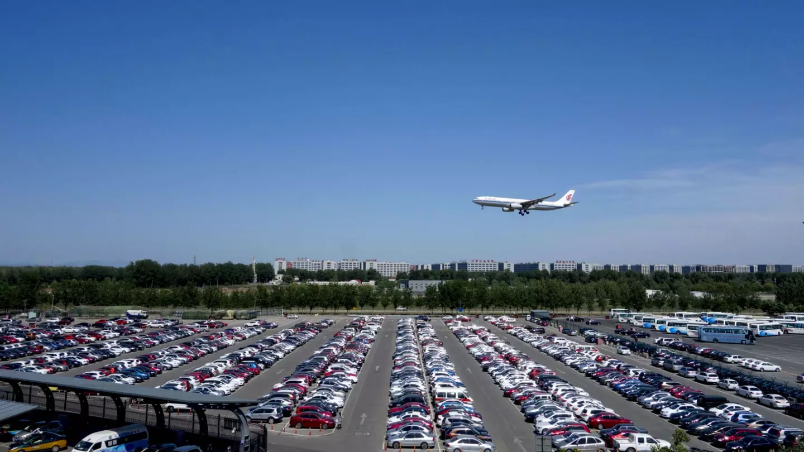
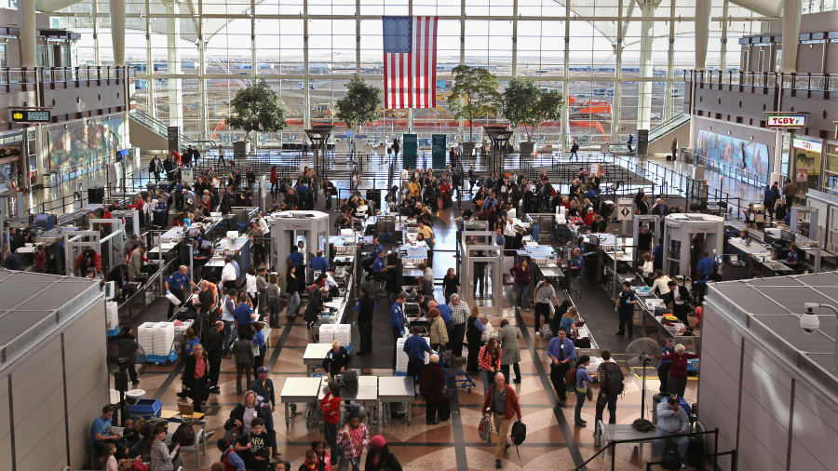
Problem
Rushed Going to the Airport
Crowded Security Creating Delays
No Close Parking is Available
Notes:
*Description of identified problem faced by customer or user

Slide 3
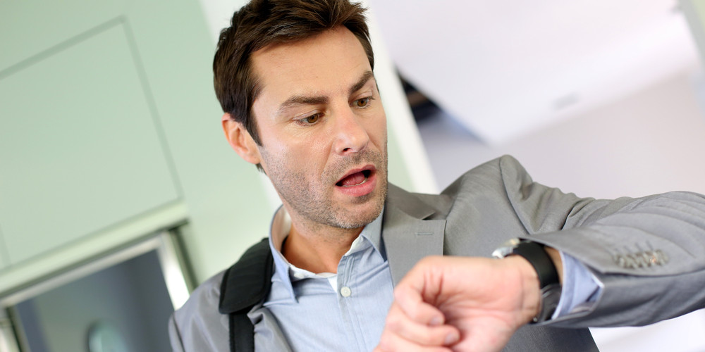
Problem Validation
Interviewed 10 people who have faced this problem. *Testimonials*
Researched statistics on *website* that show over 2% people miss their flights daily due to this problem.
Notes:
*Validation of identified problem faced by customer or user

Slide 4
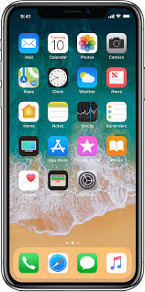
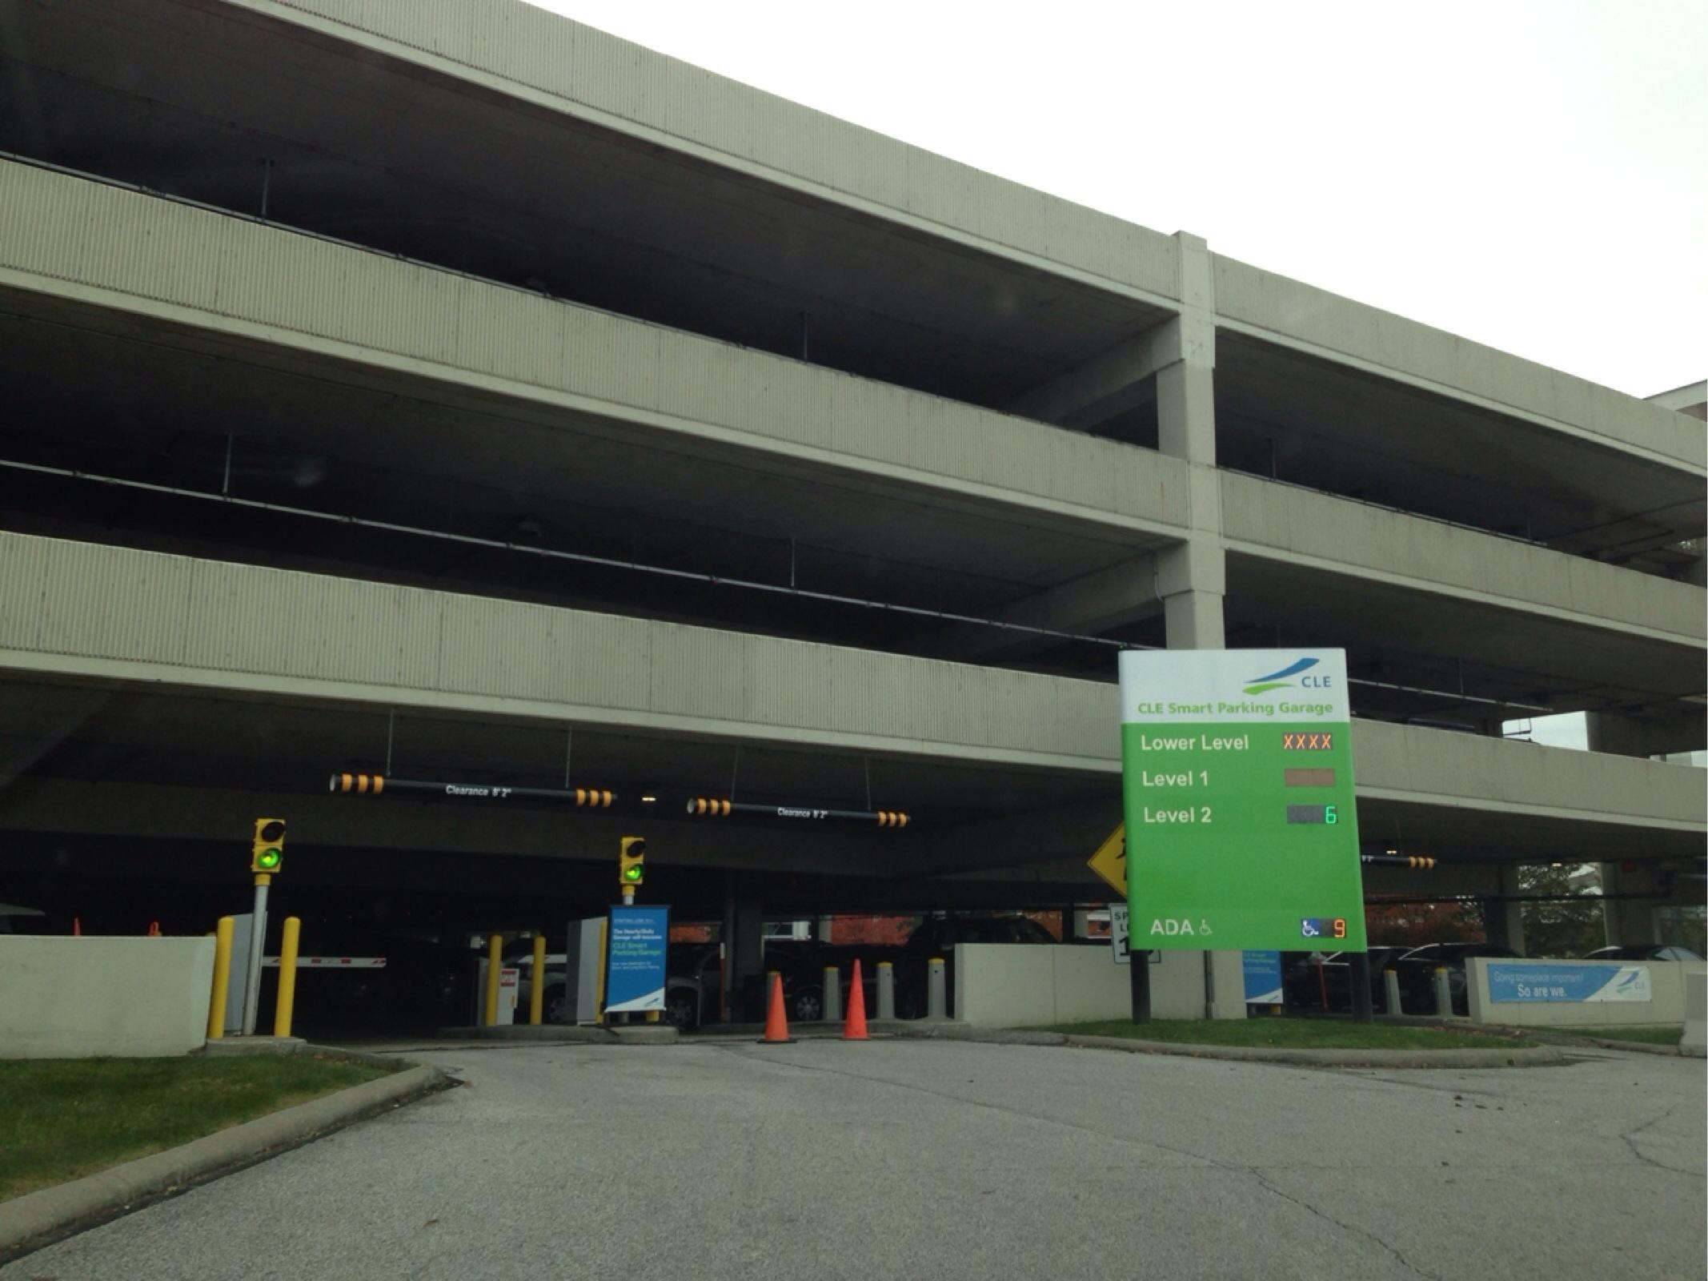
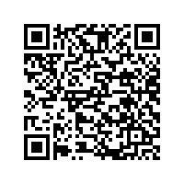
Solution
Notes:
*Description of proposed solution

Slide 5
Competition
Notes:
*Competitive landscape

Slide 6
Unique Value
Why are we different?
How can we make sure we’ll continue be different?
Notes:
*Does the venture possess a competitive advantage or provide superior value compared to others?
*How will the venture make sure it continues to have advantages?

Slide 7
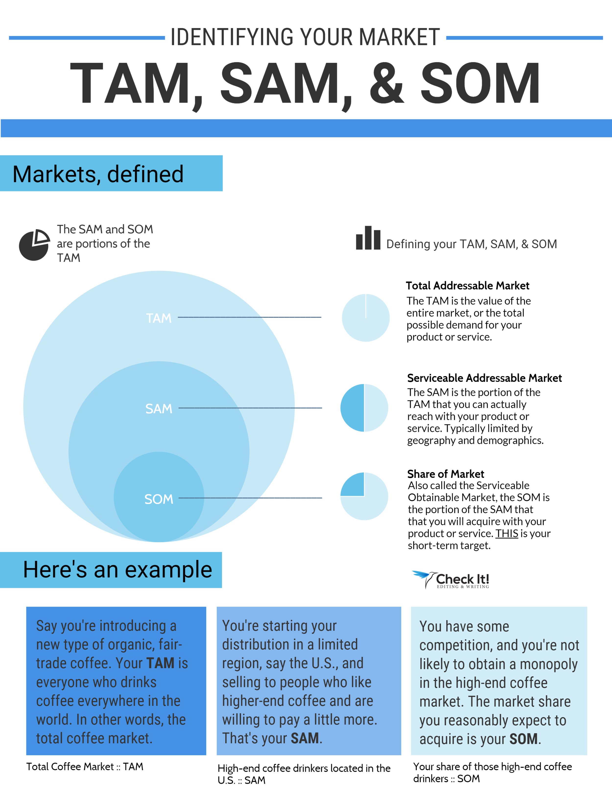
Market Size
Notes:
*Identifying the large-scale quantity/impact of the problem and measuring it down to how much the venture can capture realistically

Slide 8
Target Market
Our customers will be:
The business person
People who travel on tight schedules
Those that enjoy convenience and no stress traveling
These customers will be attracted through:
Advertising at Airports
Online Ad Targeting
Other Promotion through Airports
At Rental Car Agencies
Ads Posted in the Airports
Notes:
*Description of the ventures ‘’target’’ market

Slide 9
Business Model
Goal of the Slide is to communicate how the venture will leverage the market.
Can contain info. on distribution, partners, beneficiaries, revenue stream, cost and pricing models, value proposition, etc.
Notes:
*Description of business / social model components
*Is the venture financially sustainable? How?

Slide 10
Financial Feasibility
The cost for our app to be developed can be anywhere from $50,000 to $100,000
To reserve a spot will cost around $30 per day, however the prices will change depending on location and date, similar to airline tickets.
This cost is slightly more than the competition, but the competition does not offer a service like ours.
Notes:
*Financial planning / forecast

Slide 11
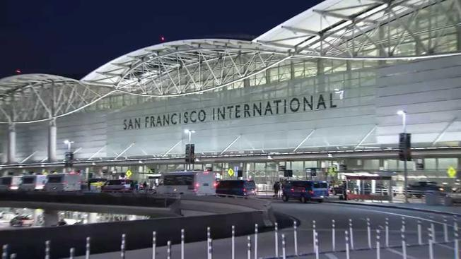
Resources
Our team will be comprised of:
App Designer
Graphic Designer
Salesperson
Implementation Manager
Support
We will need to partner with many airports around the United States. This is necessary to gain access to their parking garages to implement our system.
Notes:
*Existing skills / resources internally and externally
*Required skills / resources internally and externally – How can the venture obtain these?

Slide 12
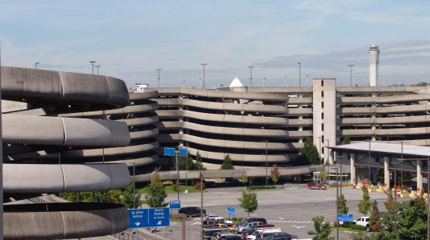
“Bring to Market” Obstacles
Notes:
*Challenges faced by the venture and team

Slide 13
Launch to Market
Next Steps:
We need to develop a mock-up and prototype of the app
Market the app to potential investors
Find an airport to allow us to “Beta” test our app and concept
Once our app is proven to work, meaning selling out every spot we are given by the airport, we will then market the app/concept to more airport with proof that it works.
Finally we will implement this app at airports all over the United States
Notes:
*Plan to grow the business

